Slide 1


The Systems Analyst’s Toolkit
Version 2 – 18th December 2015

Slide 2


Prescribed Text and recommended readings
Rosenblatt, H. J. (2016), Systems Analysis and Design.11th Edition, Cengage Learning, Boston MA
Valacich, Joseph S. & George, Joey F.(2020), Modern Systems Analysis and Design, Global Edition, 9th Edition
Robertson, S. and Robertson, J. (2013), Mastering the Requirements Process: Getting Requirements Right, 3rd Edition, Addison Wesley, Upper Saddle River, NJ
IIBA (2015), Guide to the Business Analysis Body of Knowledge, BABOK Version 3.0, International Institute of Business Analysis, http://www.iiba.org/BABOKGuide.aspx

Slide 3
Learning Objectives
3.1 Explain the process of managing an information systems project, including project initiation, project planning, project execution, and project closedown
3.2 Describe how to represent and schedule project plans using Gantt charts and network diagrams
3.3 Explain how commercial project management software packages can be used to assist in representing and managing project schedules

Slide 4
Introduction
Project management (P M) is arguably the most important aspect of an information systems development project
Effective P M helps to ensure that systems development projects:
Meet customer expectations
Are completed on time and within budget
Focus has changed to implementation of packaged software or E R P solutions

Slide 5
Pine Valley Application Project
3.1 Explain the process of managing an information systems project, including project initiation, project planning, project execution, and project closedown
Manufactures high-quality wood furniture to retail stores in the U.S.
Pine Valley (P V) was organized into the following functional areas in 2000:
Manufacturing (fabrication, assembling, finishing)
Sales
Orders
Accounting
Purchasing
Pine Valley later used 3 distinct systems as shown on the next slide

Slide 6
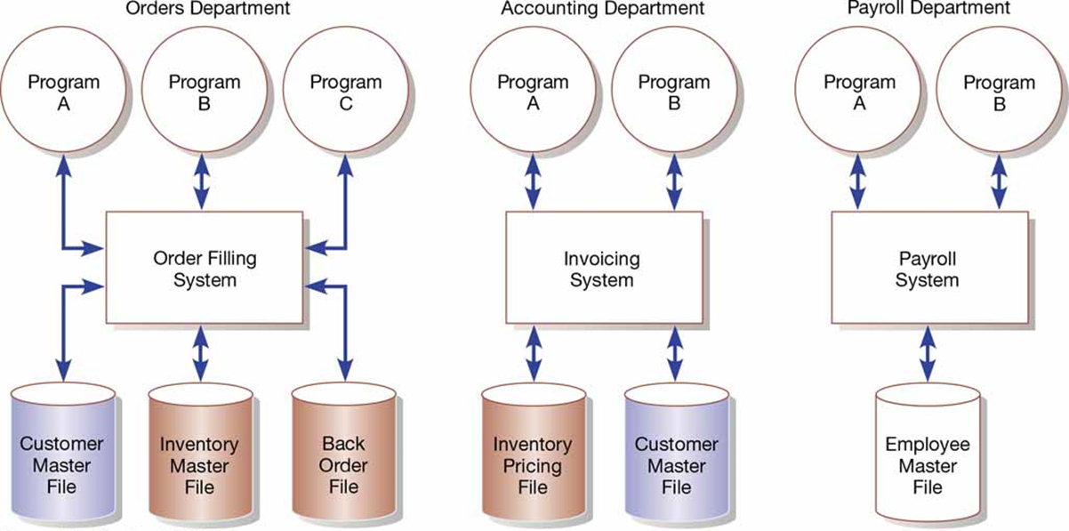
Figure 3-1: Three Computer Applications at P V F: Order Filling, Invoicing, and Payroll
(Hoffer, Jeffrey A.; Venkataraman, Ramesh; Topi, Heikki, Modern Database Management, 11th Ed., ©2016, p. 8. Reprinted and electronically reproduced by permission of Pearson Education, Inc., New York, N Y)

Slide 7
Managing the Information Systems Project
3.1 Explain the process of managing an information systems project, including project initiation, project planning, project execution, and project closedown
Project manager – systems analyst with a diverse set of skills—management, leadership, technical, conflict management, and customer relationship—who is responsible for initiating, planning, executing, and closing down a project.
Project – planned undertaking of related activities to reach an objective that has a beginning and an end
Deliverable – end product of an S D L C phase; example follows on the next slide

Slide 8
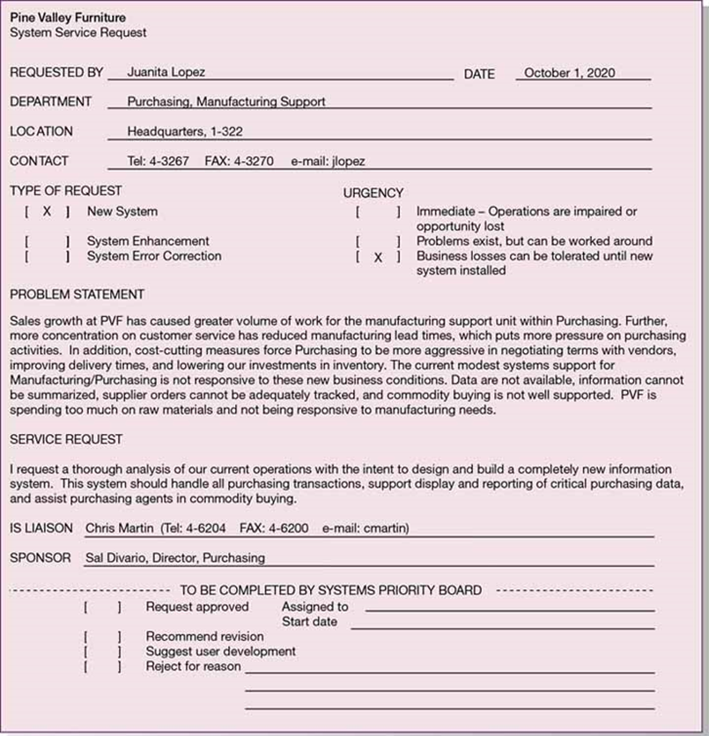
Figure 3-2: System Service Request for the Purchasing Fulfillment System with Name and Contact Information of the Person Requesting the System, a Statement of the Problem, and the Name and Contact Information of the Liaison and Sponsor

Slide 9
Deciding on Systems Projects
3.1 Explain the process of managing an information systems project, including project initiation, project planning, project execution, and project closedown
System Service Request (S S R) – standard form for requesting or proposing systems development work within an organization
Previous slide is an example
Feasibility study – study that determines whether a requested system makes economic and operational sense for an organization

Slide 10
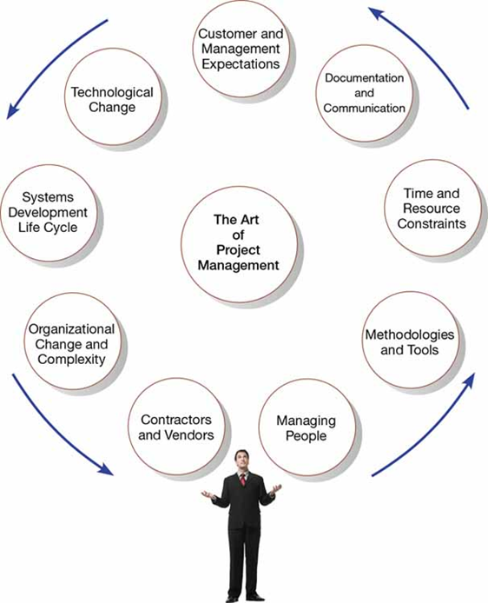
Figure 3-4: A Project Manager Juggles Numerous Activities
(Source: Media Bakery13/Shutterstock)

Slide 11
Table 3-1: Common Activities and Skills of a Project Manager
Activity | Description | Skill
Leadership | Influencing the activities of others toward the attainment of a common goal through the use of intelligence, personality, and abilities | Communications; liaison between management, users, and developers; assigning activities; monitoring progress
Management | Getting projects completed through the effective utilization of resources | Defining and sequencing activities; communicating expectations; assigning resources to activities; monitoring outcomes
Customer relations | Working closely with customers to ensure that project deliverables meet expectations | Interpreting system requests and specifications; site preparation and user training; contact point for customers
Technical problem solving | Designing and sequencing activities to attain project goals | Interpreting system requests and specifications; defining activities and their sequence; making trade-offs between alternative solutions; designing solutions to problems
Conflict management | Managing conflict within a project team to assure that conflict is not too high or too low | Problem solving; smoothing out personality differences; compromising; goal setting
Team management | Managing the project team for effective team performance | Communication within and between teams; peer evaluations; conflict resolution; team building; self-management
Risk and change management | Identifying, assessing, and managing the risks and day-to-day changes that occur during a project | Environmental scanning; risk and opportunity identification and assessment; forecasting; resource redeployment

Slide 12
Project Management
3.1 Explain the process of managing an information systems project, including project initiation, project planning, project execution, and project closedown
Project Management – controlled process of initiating, planning, executing, and closing down a project
Phases of project management:
Initiating
Planning
Executing
Closing down

Slide 13
Initiating the Project
3.1 Explain the process of managing an information systems project, including project initiation, project planning, project execution, and project closedown
Project initiation – first phase of the project management process in which activities are performed to assess the size, scope, and complexity of the project and to establish procedures to support later project activities
The next slide will show the activities associated with project initiation

Slide 14
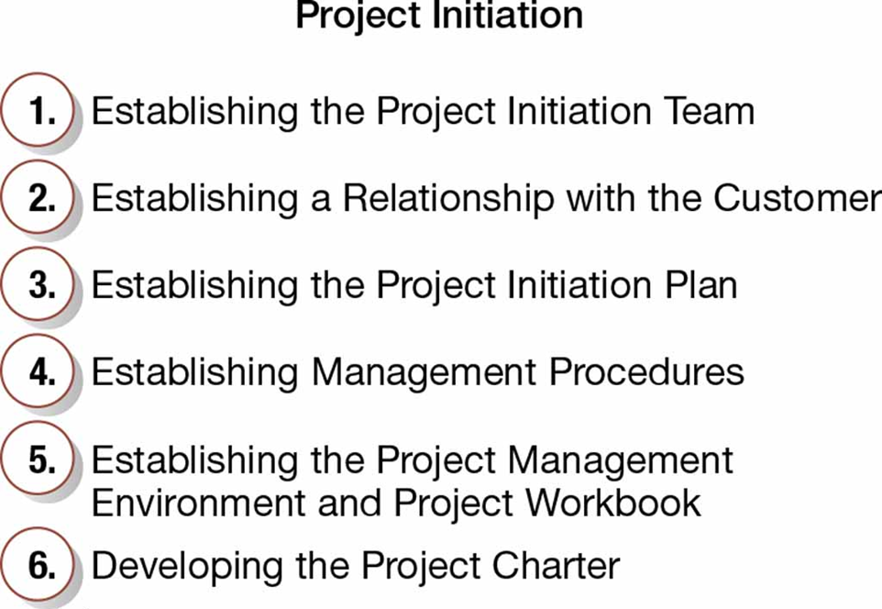
Figure 3-5: Six Project Initiation Activities

Slide 15
Project Workbook
3.1 Explain the process of managing an information systems project, including project initiation, project planning, project execution, and project closedown
Project Workbook – online repository for all project-related documents that is used for performing project audits, orienting new team members, communicating with management and customers, identifying future projects, and performing post-project review
Next slide shows the online project workbook for the Purchasing Fulfillment System

Slide 16
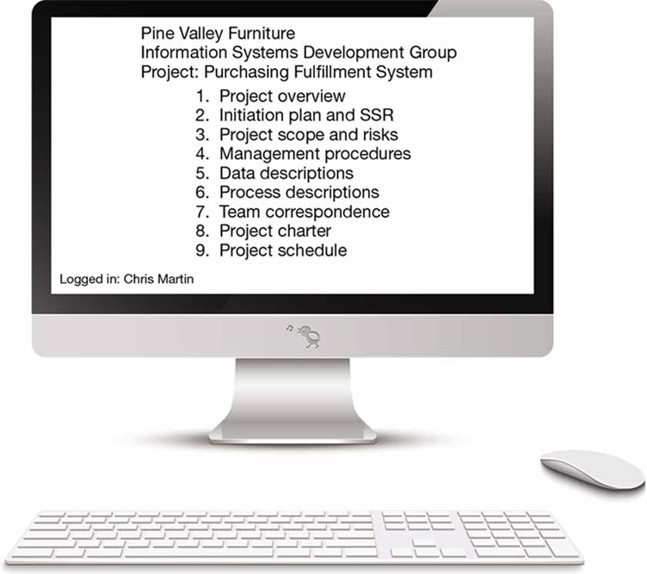
Figure 3-6: The Project Workbook for the Purchasing Fulfillment System Project Contains Nine Key Elements
(Source: A-R-T/Shutterstock)

Slide 17
Project Charter
3.1 Explain the process of managing an information systems project, including project initiation, project planning, project execution, and project closedown
Project Charter – document prepared for the customer during project invitation that describes what the project will deliver and outlines generally at a high level all work required to complete the project
The project charter usually contains:
Project title and date of authorization
Project manager name and contact information
Customer name and contact information
Projected start and completion dates
Key stakeholders, project role, and responsibilities
Project objectives and description
Key assumptions or approach
Signature section for key stakeholders

Slide 18
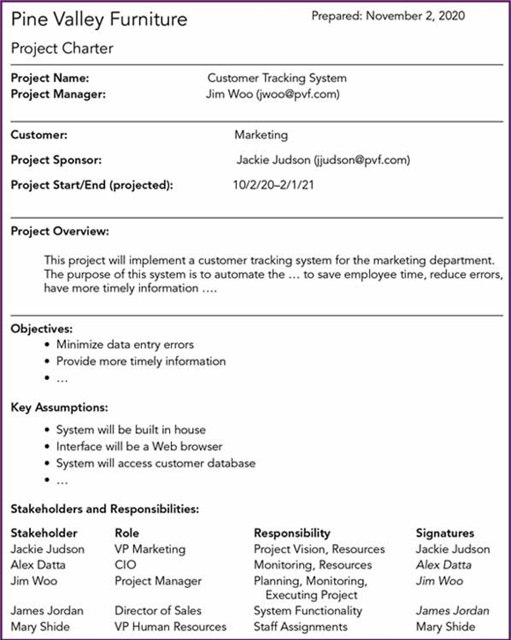
Figure 3-7: Project Charter for a Proposed Information Systems Project

Slide 19
Planning the Project
3.1 Explain the process of managing an information systems project, including project initiation, project planning, project execution, and project closedown
Project planning – second phase of the project management process that focuses on defining clear, discrete activities and the work needed to complete each activity within a single project
Work breakdown structure – process of dividing the project into manageable tasks and logically ordering them to ensure a smooth evolution between tasks
Gantt chart – graphical representation of a project that shows each task as a horizontal bar whose length is proportional to its time for completion

Slide 20
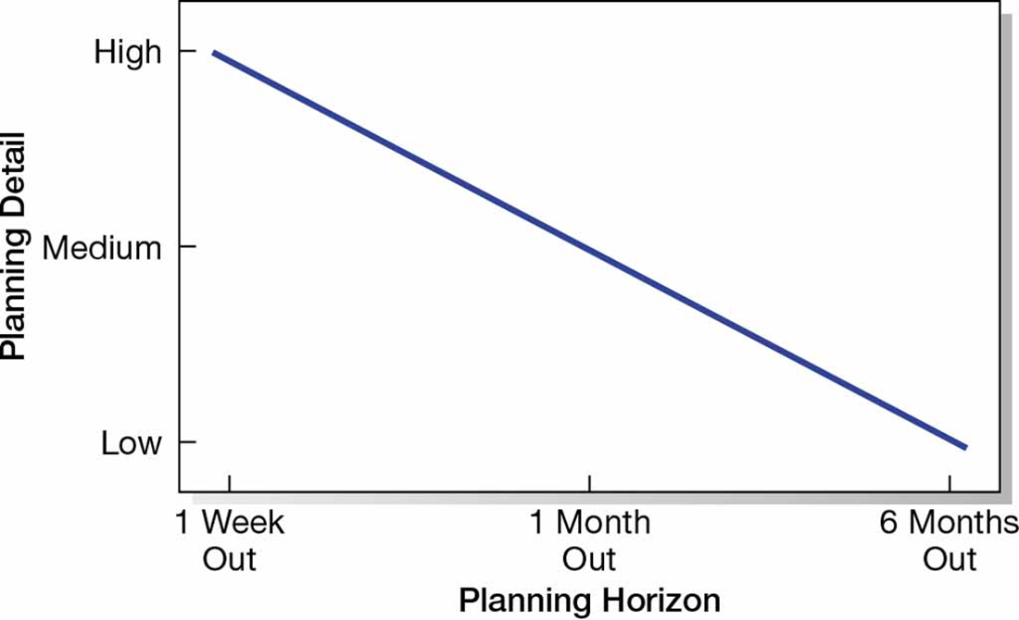
Figure 3-8: Level of Project Planning Detail Should Be High in the Short Term, with Less Detail as Time Goes On

Slide 21
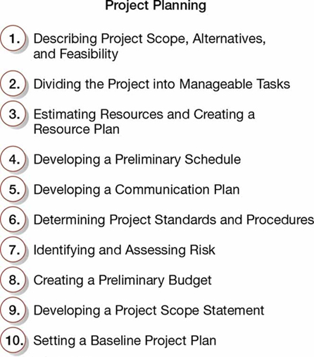
Figure 3-9: Ten Project Planning Activities

Slide 22
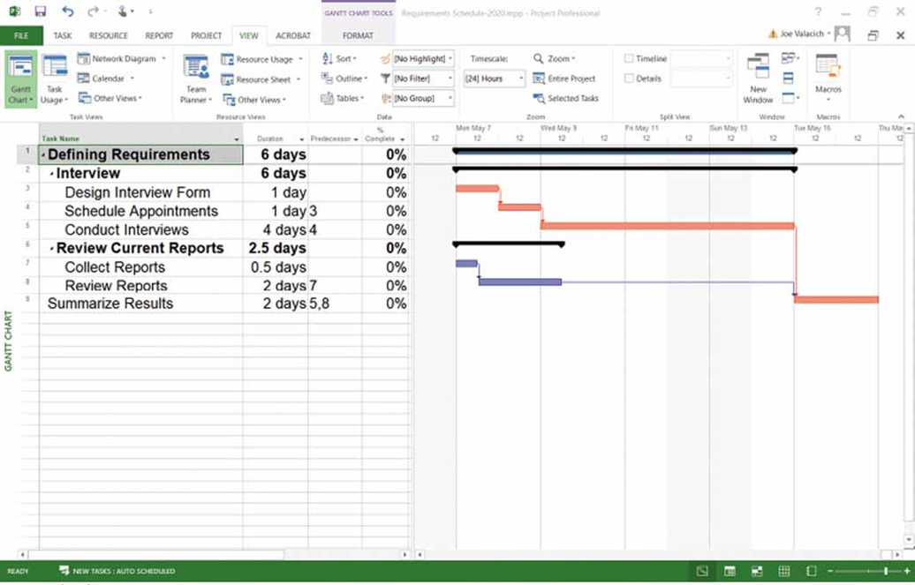
Figure 3-10: Gantt Chart Showing Project Tasks, Duration Times for Those Tasks, and Predecessors
(Source: Microsoft Corporation)

Slide 23
The Constructive Cost Model
3.1 Explain the process of managing an information systems project, including project initiation, project planning, project execution, and project closedown
Constructive cost model (C O C O M O) – automated software estimation model that uses historical project data and current as well as future project characteristics to estimate project costs
Network diagram – diagram that depicts project tasks and their relationships

Slide 24
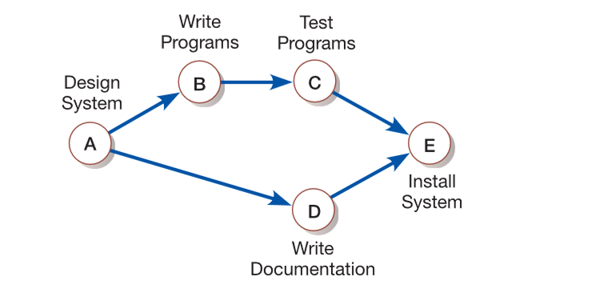
Figure 3-20: Network Diagram Showing Activities (Represented by Circles) and Sequences of Those Activities (Represented by Arrows)

Slide 25
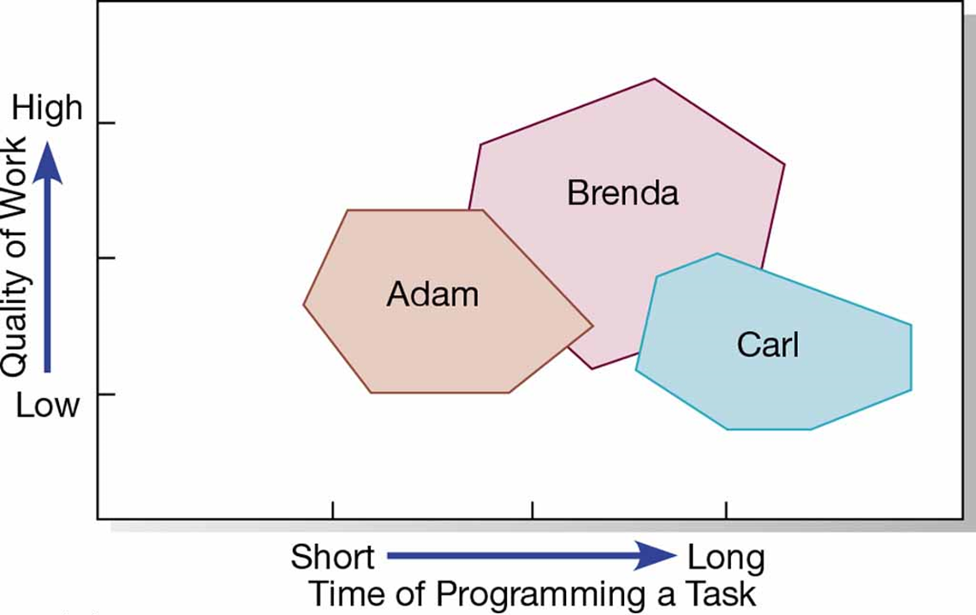
Figure 3-11: Trade-Offs Between Program Code Quality versus The Speed of Programming

Slide 26
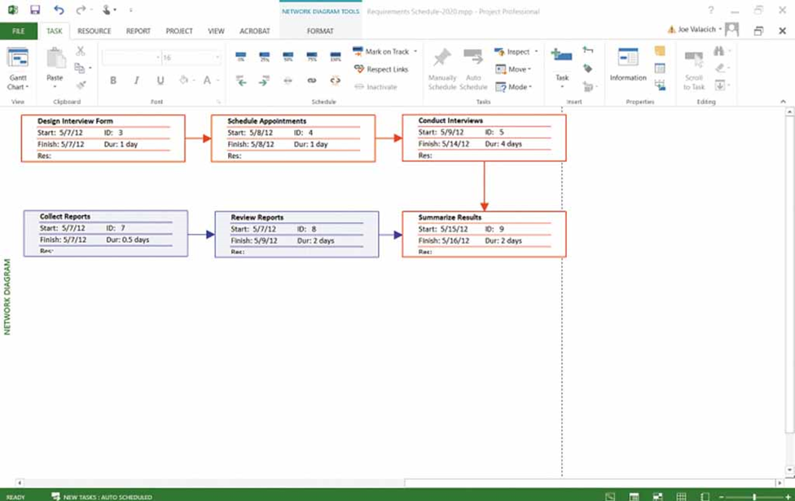
Figure 3-12: A Network Diagram Illustrates Tasks with Rectangles (or Ovals) and the Relationships and Sequences of Those Activities with Arrows
(Source: Microsoft Corporation)

Slide 27
Developing a Communication Plan
3.1 Explain the process of managing an information systems project, including project initiation, project planning, project execution, and project closedown
Who are the stakeholders for this project?
What information does each stakeholder need?
When does the information need to be produced?
What sources will be used to gather this information?
Who will collect, store, and verify the accuracy of the info?
Who will organize and package this info into a document?
Who is the contact person for each stakeholder?
What format will be used to package this information?
What communication medium should be used?

Slide 28
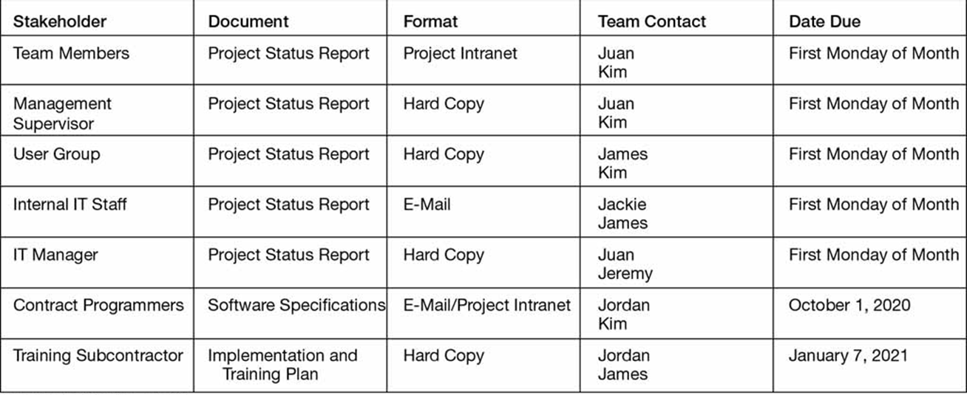
Figure 3-13: The Project Communication Matrix Provides a High-Level Summary of the Communication Plan

Slide 29
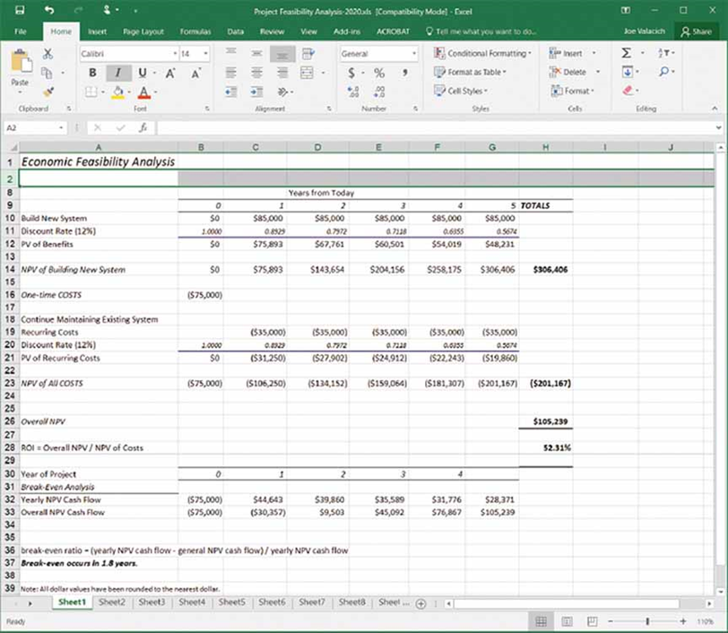
Figure 3-14: Economic Feasibility Analysis
(Source: Microsoft Corporation)

Slide 30
Executing the Project
3.1 Explain the process of managing an information systems project, including project initiation, project planning, project execution, and project closedown
Project execution – third phase of the project management process, in which the plans created in the prior phase (project initiation and planning) are put into action

Slide 31
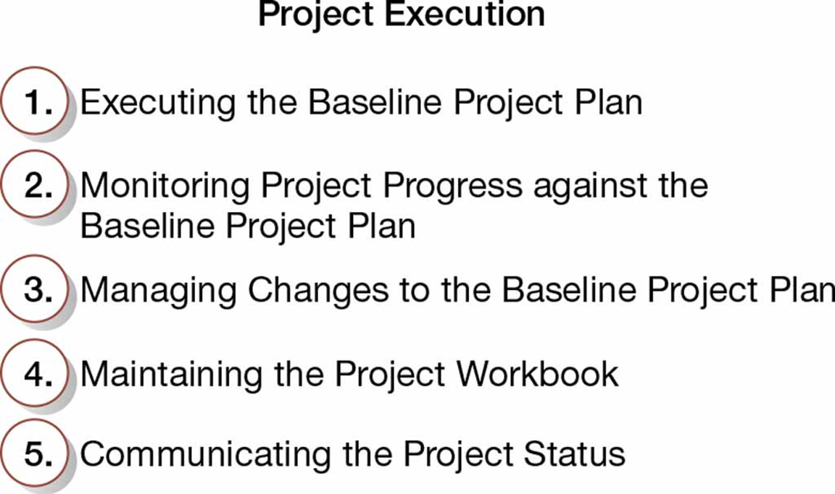
Figure 3-15: Five Project Execution Activities

Slide 32
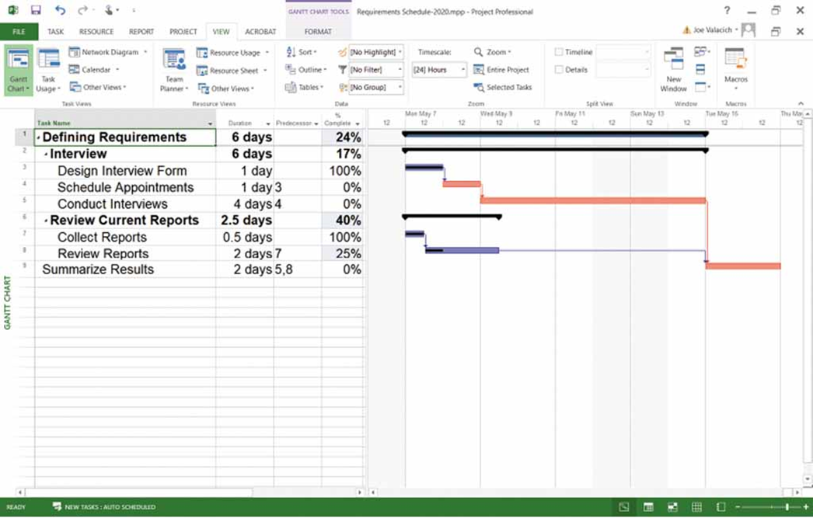
Figure 3-16: Gantt Chart with Tasks 3 and 7 Completed, and Task 8 Partially Completed
(Source: Microsoft Corporation)

Slide 33
Table 3-2: Project Team Communication Methods
Procedure | Formality | Use
Project workbook | High | Inform Permanent record
Meetings | Medium to high | Resolve issues
Seminars and workshops | Low to medium | Inform
Project newsletters | Medium to high | Inform
Status reports | High | Inform
Specification documents | High | Inform Permanent record
Minutes of meetings | High | Inform Permanent record
Bulletin boards | Low | Inform
Memos | Medium to high | Inform
Brown bag lunches | Low | Inform
Hallway discussions | Low | Inform Resolve issues

Slide 34
Closing Down the Project
3.1 Explain the process of managing an information systems project, including project initiation, project planning, project execution, and project closedown
Project closedown – final phase of the project management process, which focuses on bringing a project to an end

Slide 35
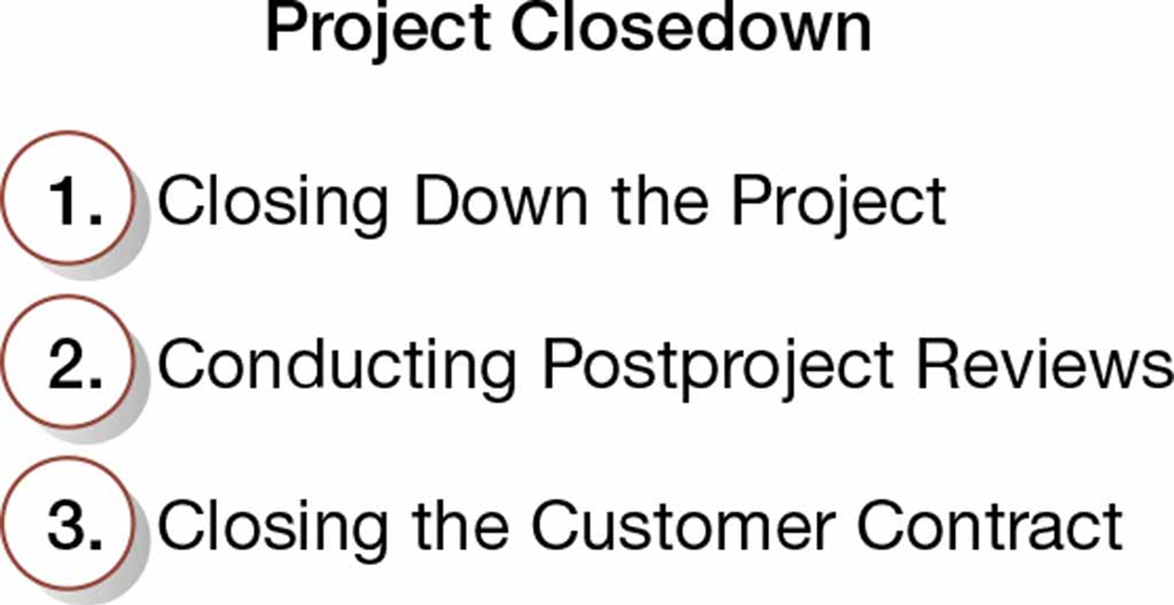
Figure 3-17: Three Project Closedown Activities

Slide 36
Representing and Scheduling Project Plans
3.2 Describe how to represent and schedule project plans using Gantt charts and network diagrams
Project managers have a variety of techniques for depicting and documenting project plans
Graphical or text-based
Examples: Gantt charts, network diagrams

Slide 37
Gantt Charts versus Network Diagrams
3.2 Describe how to represent and schedule project plans using Gantt charts and network diagrams
Gantt charts
Show task durations
Show time overlap
Show slack time in duration
Network diagrams
Show task dependencies
Do not show time overlap, but show parallelism
Show slack time in boxes

Slide 38
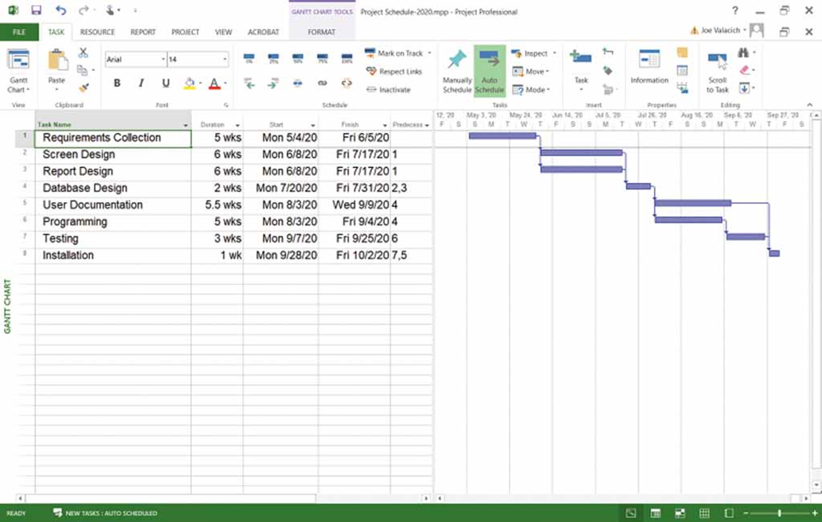
Figure 3-18(a): Graphical Diagrams That Depict Project Plans—Gantt Chart
(Source: Microsoft Corporation)

Slide 39
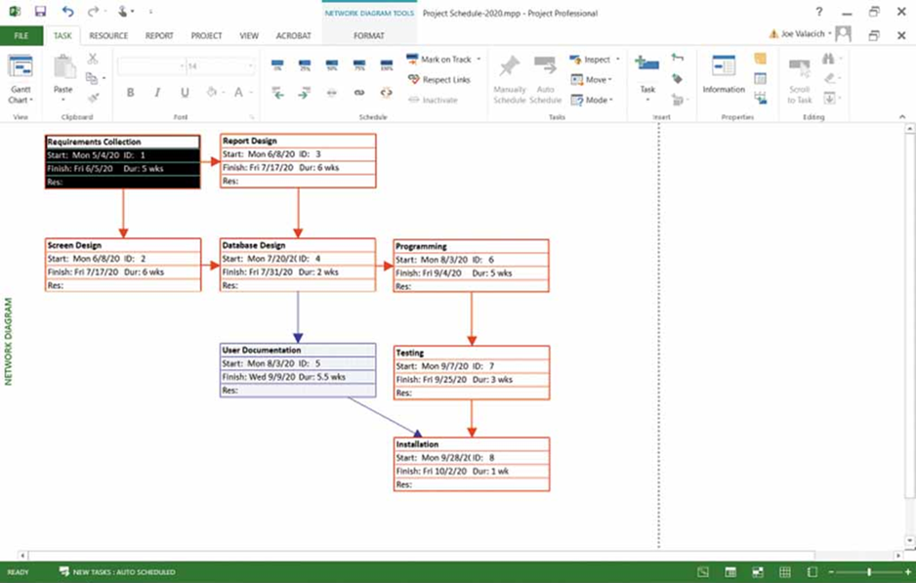
Figure 3-18(b): Graphical Diagrams That Depict Project Plans—Network Diagram
(Source: Microsoft Corporation)

Slide 40
Representing Project Plans
3.2 Describe how to represent and schedule project plans using Gantt charts and network diagrams
Resources – any person, group of people, piece of equipment, or material used in accomplishing an activity
Critical path scheduling – scheduling technique whose order and duration of a sequence of task activities directly affect the completion date of a project
P E R T (Program Evaluation Review Technique) – technique that uses optimistic, pessimistic, and realistic time estimates to calculate the expected time for a particular task

Slide 41
Estimated Task Duration
3.2 Describe how to represent and schedule project plans using Gantt charts and network diagrams
The P E R T technique uses optimistic (o), pessimistic (p), and realistic (r) time estimates to determine expected task duration.
Formula for Estimated Time:

Slide 42
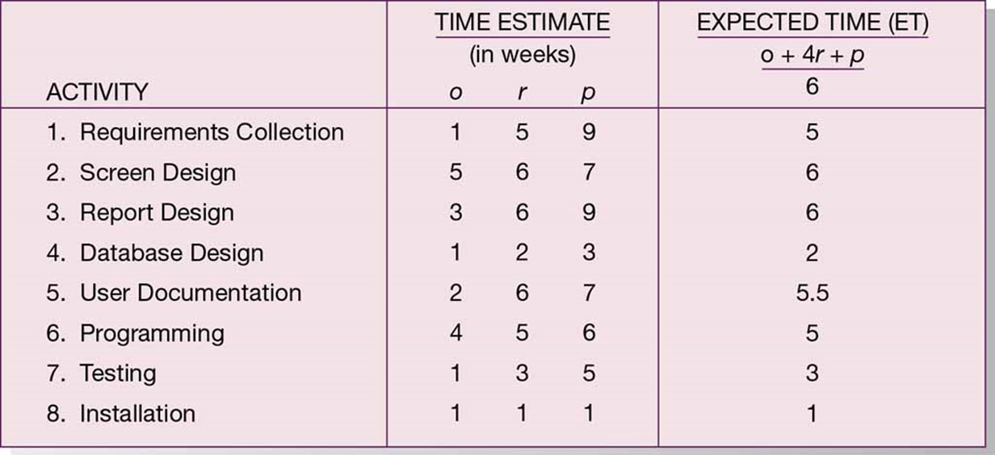
Figure 3-21: Estimated Time Calculations for the S P T S Project

Slide 43
Critical Path Scheduling
3.2 Describe how to represent and schedule project plans using Gantt charts and network diagrams
A scheduling technique whose order and duration of a sequence of task activities directly affect the completion
Critical path – shortest time in which a project can be completed
Slack time – amount of time that an activity can be delayed without delaying the project

Slide 44
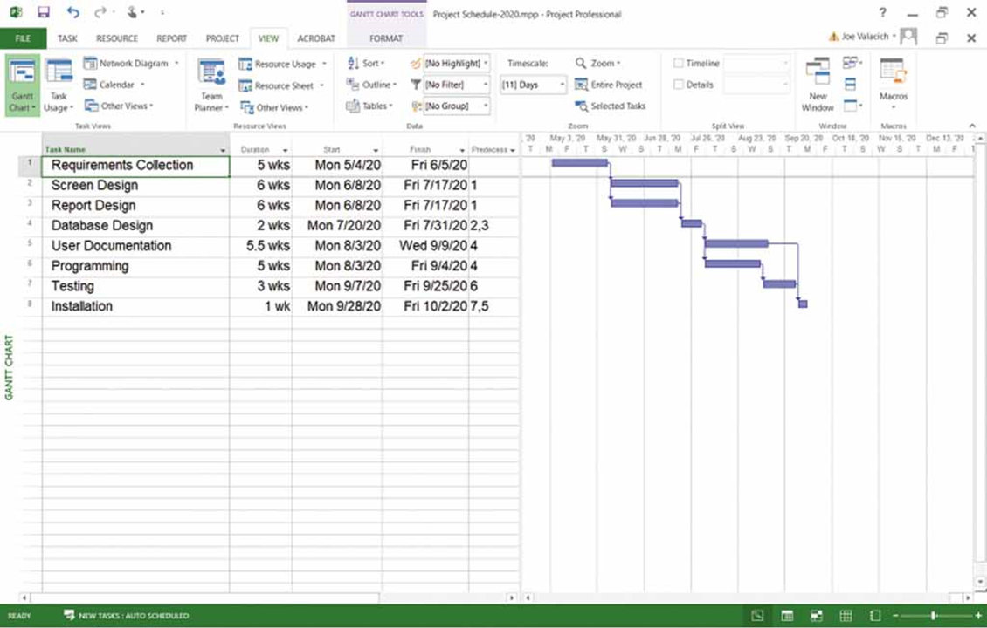
Figure 3-23: Gantt Chart That Illustrates the Sequence and Duration of Each Activity of the S P T S Project
(Source: Microsoft Corporation)

Slide 45
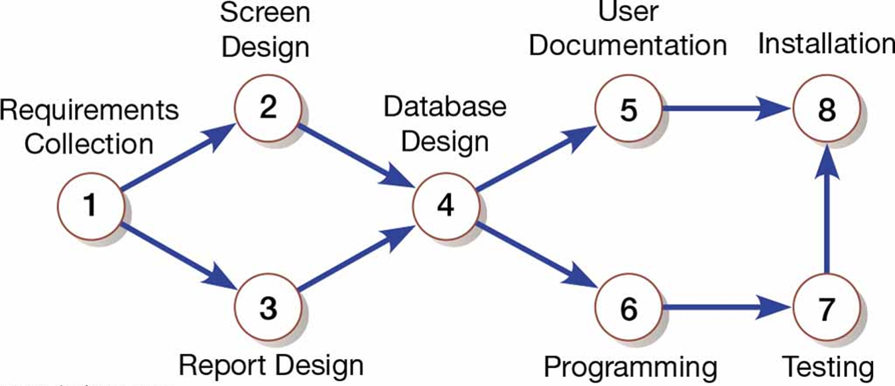
Figure 3-24: A Network Diagram That Illustrates the Activities (Circles) and the Sequence (Arrows) of Those Activities

Slide 46
Determining the Critical Path
3.2 Describe how to represent and schedule project plans using Gantt charts and network diagrams
Calculate the earliest possible completion time for each activity by summing the activity times in the longest path to the activity giving the expected project time
Calculate the latest possible completion time for each activity by subtracting the activity times in the path following the activity from the total expected time giving the slack time for activities
Critical path contains no activities with slack time

Slide 47
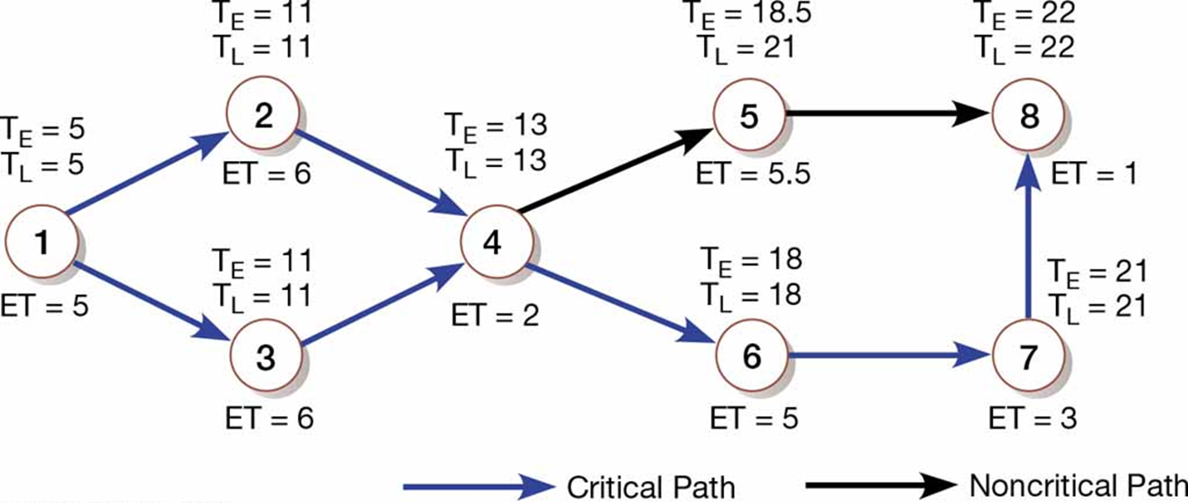
Figure 3-25: A Network Diagram for the S P T S Project Showing Estimated Times for Each Activity and the Earliest and Latest Expected Completion Time for Each Activity

Slide 48
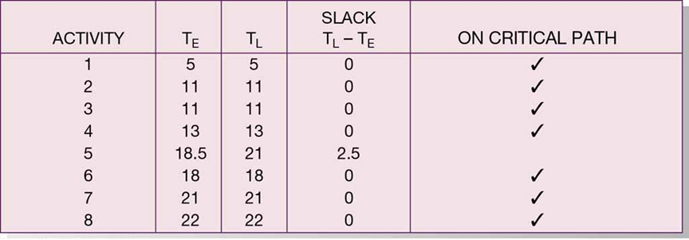
Figure 3-26: Activity Slack Time Calculations for the S P T S Project; All Activities Except Number 5 Are on the Critical Path

Slide 49
Using Project Management Software
3.3 Explain how commercial project management software packages can be used to assist in representing and managing project schedules
Many powerful software tools exist for assisting with project management
Microsoft Project is an example that can be used to:
Establish a project starting or ending date
Enter tasks and assign task relationships
Select a scheduling method to review project reports

Slide 50
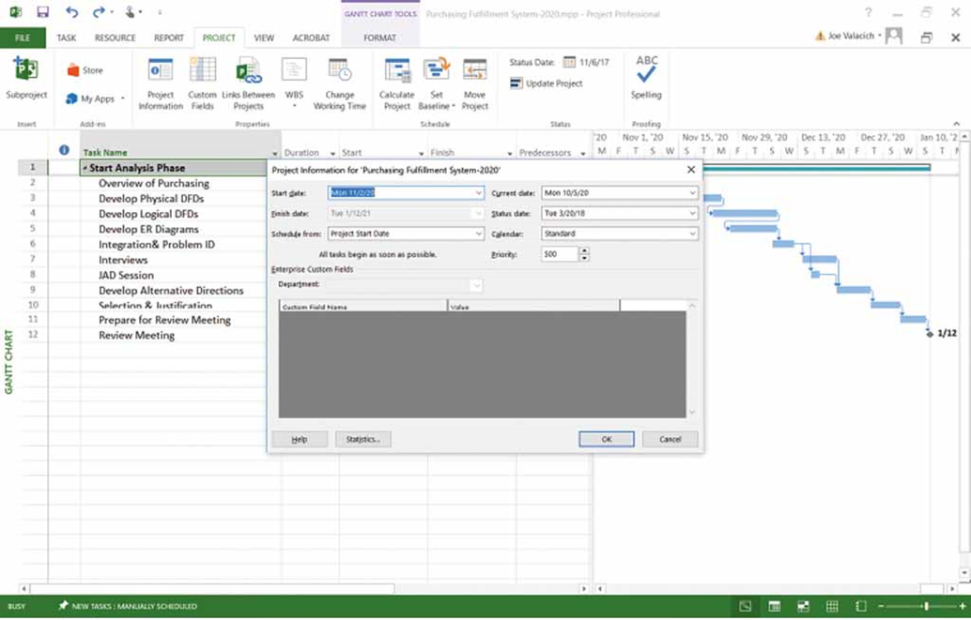
Figure 3-27: Establishing a Project Starting Date in Microsoft Project
(Source: Microsoft Corporation)

Slide 51
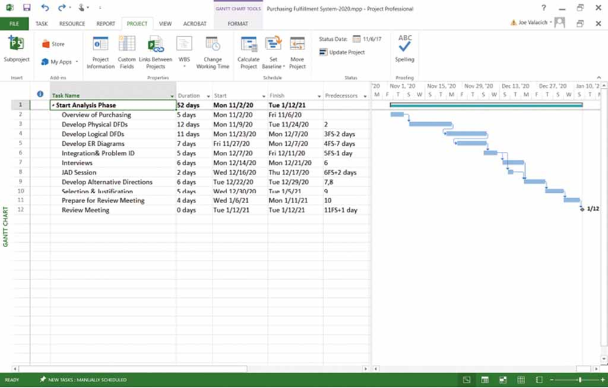
Figure 3-28: Entering Tasks and Assigning Task Relationships in Microsoft Project
(Source: Microsoft Corporation)

Slide 52
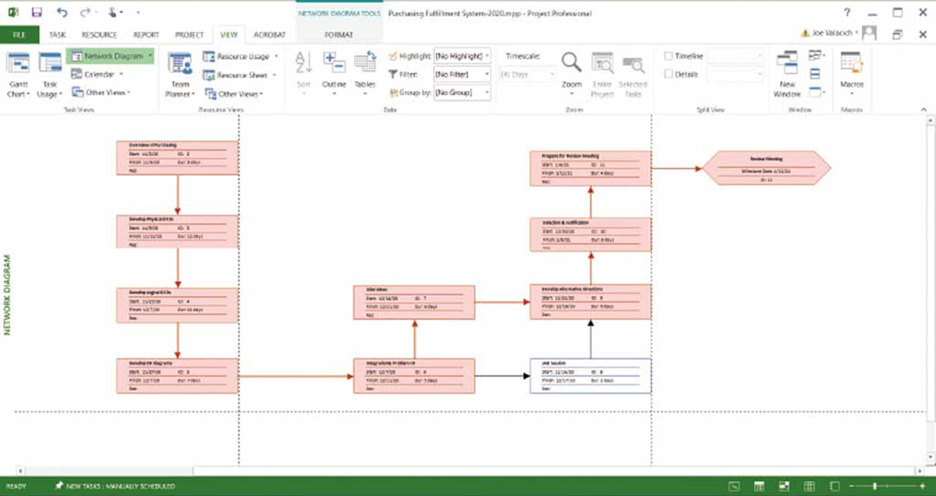
Figure 3-29: Viewing Project Information as a Network Diagram in Microsoft Project
(Source: Microsoft Corporation)

Slide 53
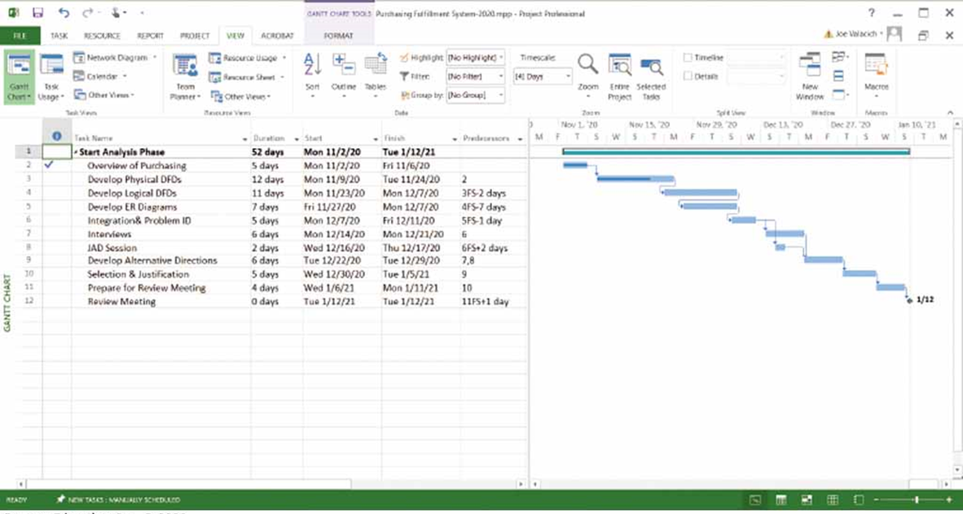
Figure 3-30: Gantt Chart Showing Progress of Activities (Right Frame) Versus Planned Activities (Left Frame)
(Source: Microsoft Corporation)

Slide 54
Summary
In this chapter you learned to:
Explain the process of managing an information systems project, including initiation, project planning, project execution, and project closedown
Describe how to represent and schedule project plans using Gantt charts and network diagrams
Explain how commercial project management software packages can be used to assist in representing and managing project schedules

